Slide 1
IT306
Module 6
Queue and Stack

Slide 2
Recap: LinkedList
Chain of linked nodes
Flexibility and extensibility in size (dynamic size)
Linear data structure
Each node is a separate object
Ease of insertion and deletion
No support for random access
Extra memory pointer required for each element of the list

Slide 3



Recap: Node Data Definition Class
public class Node{
private int data;
private Node next;
private static int total;
public Node(int d,Node n){
data=d; next=n;
total++;
}
public Node getNext(){ return next; }
public int getData(){return data; }
}
public class Node{
private Student data;
private Node next;
private static int total;
public Node(Student d,Node n){
data=d; next=n;
total++;
}
public Node getNext(){ return next; }
public Student getData(){return data; }
}
Notes:
Increment a counter outside of the Node class each time a new node is initialized, or adding a static field to preserve the length of the linkedlist.

Slide 4
Recap: Example
Part-a: Given the class “Node”, create a instance method that stores input data in a linked list one at a time.
head
tail
data1
data2
…
data n
Procedure Add to the end of a list:
Read data from input
Create a new node and fill its data component, then make that a null reference.
Link that to the tail node in the list.
Update tail.
Part-b: What if we want to add to the beginning of the list?
(Your turn now)
new node
head
tail
data1
data2
…
data n

Slide 5
Recap: Class LinkedList<E>
java.util.LinkedList<E>
E: type of elements held in this collection
Implemented interfaces
Serializable, Cloneable, Iterable<E>, Collection<E>, Deque<E>, List<E>,Queue<E>
Example:
LinkedList<String> strList = new LinkedList<String>();
LinkedList<Integer> intList = new LinkedList<Integer>();
LinkedList<Scientist> sciList = new LinkedList<Scientist>();
Notes:
To serialize an object means to convert its state to a byte stream so that the byte stream can be reverted back into a copy of the object. A Java object is serializable if its class or any of its superclasses implements either the java.io.Serializable interface or its subinterface, java.io.Externalizable.

Slide 6
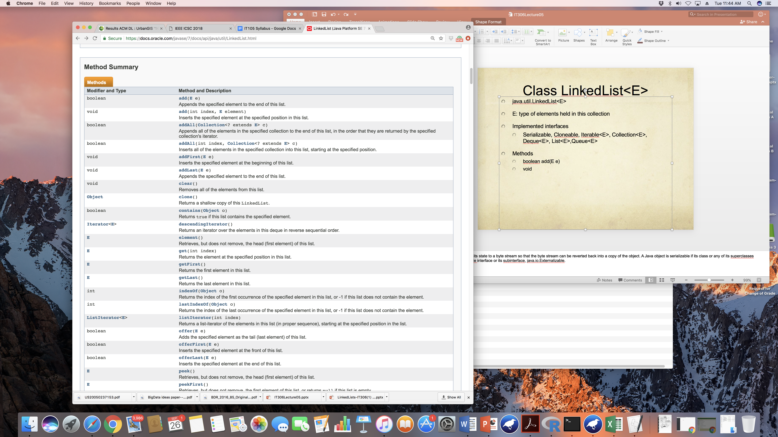
Recap: Class LinkedList<E> : Methods

Slide 7
Recap: Class LinkedList<E> : Methods

Slide 8
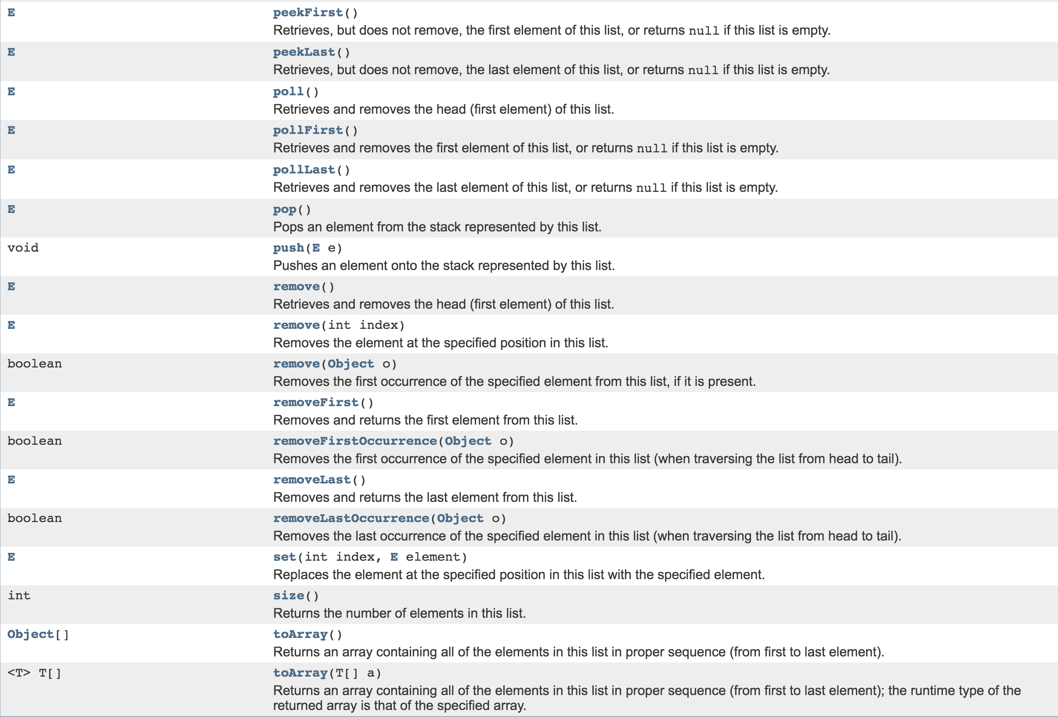
Recap: Class LinkedList<E> : Methods

Slide 9
Data Structures Represented by LinkedList
Stack
Queue
Priority Queue
Binary Tree
Binary Heap

Slide 11
Stack
Dynamic Data Structure (size of the collection must not be predefined)
Follows Last In First Out (LIFO) Principle- Restricted accessibility
Example: you have a stack of trays on a table. The tray at the top of the stack is the first item to be moved if you require a tray from that stack.
Simple way of building a collection
No need for indexing
The last item to be inserted into a stack is the first one to be deleted from it.

Slide 12
Stack: Insert and Delete Operations
Restrictions for insertion and Deletion of elements:
Elements can be inserted or deleted only from the end of the stack, i.e., from the top.
The element at the top of the stack is called the top element.
Operations
Insert operation: Push an object onto a Stack
When an element is pushed onto a stack, it becomes the new top element of the stack.
Delete operation: Pop an object out of a Stack
When the top element of a stack is deleted, if the stack remains non-empty, then the element just below the previous top element becomes the new top element of the stack.
For example, in the stack of trays, if you take the tray on the top and do not replace it, then the second tray automatically becomes the top element (tray) of that stack.
Exception Handling
StackOverflow
StackUnderflow

Slide 13
Stack Data Structure in Java
java.util.Stack;
Stack<Character> s = new Stack<Character>();
)
Example:
Input:
2*(4+6)
Output:
Valid expression
Evaluation = 20
top
d
s.push(xi):
X = {a , b , c , d}
xi = s.pop() returns {d,c,b,a} if called multiple times, as long as the stack is not empty.
6
insert = s.push(object)
Return and remove object= s.pop()
Examine the last object/element, no remove operation: s.peek()
Check if the stack is empty: boolean = s.isEmpty()
Return the 1-based position where an object is on the stack: int position= Search(Object o)
Example: s.search(‘d’) returns 1 ; s.search(‘a’) returns 4.
c
+
b
4
a
(
*
2

Slide 14
Stacks
How would you implement a Stack ?
Array
LinkedList

Slide 15
Array Implementation of a Stack
push(x)
void push (char [ ] stack , char x , int n) {
if ( top == n-1 ) {
//If the top position is the last of position in a stack,
//this means that the stack is full
throw new RuntimeException(“Stack overflow”);
}
else{ top = top +1 ;
//Incrementing top position
stack[ top ] = x ;
//Inserting element on incremented position
}
}

Slide 16
Array Implementation of a Stack
pop()
char pop (char [ ] stack ,int n ) {
if( isEmpty ( ) ) {
throw new RuntimeException(“Stack underflow”);
}
char out = stack[top];
top = top - 1 ; //Decrementing top’s position will detach last element from stack
return out;
}

Slide 17
LinkedList implementation of a Stack
s.push(‘d’)
d
top
c
null
next
top
c
b
a
Node n = new Node(‘d’,null);
b
next
a
Stack
null
LinkedList

Slide 18
LinkedList implementation of a Stack
top
d
next
s.push(‘d’)
oldtop
c
top
d
c
b
a
next
Node n = new Node(‘d’,null);
Node oldTop = top;
top=n;
top.setNext(oldTop);
b
next
a
Stack
null
LinkedList

Slide 19
LinkedList implementation of a Stack
top
d
next
s.push(‘d’)
c
top
d
c
b
a
next
Node n = new Node(‘d’,null);
Node oldTop = top;
top=n;
top.setNext(oldTop);
b
next
a
Stack
null
LinkedList

Slide 20
LinkedList implementation of a Stack
oldTop
d
top
next
s.pop()
c
top
d
c
b
a
next
Character data = top.getData();
Node oldTop = top;
top = top.getNext();
b
next
a
Stack
null
LinkedList

Slide 21
LinkedList implementation of a Stack
oldTop
d
null
s.pop()
top
c
top
next
c
b
a
Character data = top.getData();
Node oldTop = top;
top = top.getNext();
oldTop.setNext(null);
oldTop = null;
return data;
b
next
a
Stack
null
LinkedList

Slide 22
Mathematical Expression Validation
)
Input:
2*(4+6)
Output:
Valid expression
Validation:
LEFT_NORMAL=‘(‘
RIGHT_NORMAL=‘)’
LEFT_CURLY=‘{‘
RIGHT_CURLY=‘}’
LEFT_SQUARE=‘[‘
RIGHT_SQUARE=‘]’
6
+
4
(
*
If character ==‘)’ && pop()
!=character || pop()==null then
Invalid expression.
2
(
characters

Slide 23
Algorithm for the previous slide
From the input string, process characters one by one
If a character is left-bracket symbol, push it onto a stack
If a character is right-bracket symbol, pop once from the stack and compare the popped element to the current character. If they are not equal, the expression is invalid. Otherwise, continue until the input array is fully processed and the stack is empty.
If the stack is not empty, the expression is invalid.

Slide 24
Evaluating a Mathematical Expression
[(4+6+1) x 2 ] – 3 =?
)
+
+
(
[
1
6
4
+
num_stack
op_stack
1
6

Slide 25
Evaluating a Mathematical Expression
[(4+6+1) x 2 ] – 3 =?
)
+
7
4
+
(
[
4
+
num_stack
op_stack
1
6

Slide 26
Evaluating a Mathematical Expression
[(4+6+1) x 2 ] – 3 =?
)
+
11
(
[
4
+
num_stack
op_stack
1
6

Slide 27
Evaluating a Mathematical Expression
[(4+6+1) x 2 ] – 3 =?
]
x
2
+
2
11
x
[
4
+
num_stack
op_stack
1
6

Slide 28
Evaluating a Mathematical Expression
[(4+6+1) x 2 ] – 3 =?
]
x
2
+
22
[
4
+
num_stack
op_stack
1
6

Slide 29
Evaluating a Mathematical Expression
[(4+6+1) x 2 ] – 3 =?
-
3
x
2
+
3
22
-
4
+
num_stack
op_stack
1
6

Slide 30
Evaluating a Mathematical Expression
[(4+6+1) x 2 ] – 3 =?
-
3
x
2
+
19
4
+
num_stack
op_stack: Empty
1
6

Slide 31
Evaluating a Mathematical Expression
[(4+6+1) x 2 ] – 3 = 19
-
3
x
2
+
4
+
num_stack : Empty
op_stack: Empty
1
6

Slide 32
Algorithm for the previous slide
From the input string, process characters one by one until the string is completely processed:
If a character is a numeric, push it onto num_stack.
If a character is a left-bracket symbol or binary operator, push it onto op_stack.
If a character is a right-bracket symbol, then
Until the equivalent left-bracket is reached, do:
Store op_stack.pop() in var
If var is a binary operator:
num_stack.pop and store in num_1
num_stack.pop and store in num_2
num_stack.push evaluate(num_1, var ,num_2)
else, op_stack.pop() and compare the popped element with var, it should be the left equivalent of var; do nothing. If not, return error ”invalid expression”.
Else, repeat steps I,II, and/or III
return num_stack.pop()
Notes:
And /OR: is there is no right bracket left then I,II.

Slide 33
Stack: Your Turn now
Write an algorithm that reverses a String in-place (no extra storage is used).
What is the temporal complexity?
top
d
Input :
a,b,c,d
Output :
d,c,b,a
c
b
a

Slide 34
Stack: Your Turn now
Write an algorithm that uses Stack data structure to print the characters of a String in its original order.
Determine the temporal complexity.
top
d
Input :
a,b,c,d
Output :
a,b,c,d
c
b
a

Slide 35
Applications of Stack
String Processing
Bracket Parsing
Recursion

Slide 36
A look into the JVM
Inside the JVM a stack is used to
create the local variables
to store the return address from a call
to pass the method-parameters

Slide 37
A look into the JVM
Every call to a method creates a new set of local variables !
These Variables are created on the stack and deleted when the method returns

Slide 38
A look into the JVM
1 public static void main(String args[ ]){
2 int a = 3;
3 int b = timesFive(a);
4 System.out.println(b+““);
5 }
6 Public int timesFive(int a){
7 int b = 5;
8 int c = a * b;
9 return (c);
10 }
c = 15
b = 5
a = 3
Return to LINE 3
b
a = 3

Slide 39
A look into the JVM
...
return (c);
...
Temporary storage
15
Return to LINE 3
Return to LINE 3
c = 15
b = 5
a = 3
Return to LINE 3
c = 15
Clear Stack
b
b
b
a = 3
a = 3
a = 3

Slide 40
A look into the JVM
1 public static void main(String args[ ]){
2 int a = 3;
3 int b = timesFive(a);
4 System.out.println(b+““);
5 }
c = 15
b
b = 15
a = 3
a = 3
Temporary storage

Slide 41
A look into the JVM
1 public static void main(String args[ ]){
2 int a = 3;
3 int b = timesFive(a);
4 System.out.println(b+““);
5 }
clear stack from local variables

Slide 42
Recursion
What’s behind this function ?
public int f(int a){
if (a==1)
return(1);
else
return(a * f( a-1));
}
It computes f! (factorial)

Slide 43
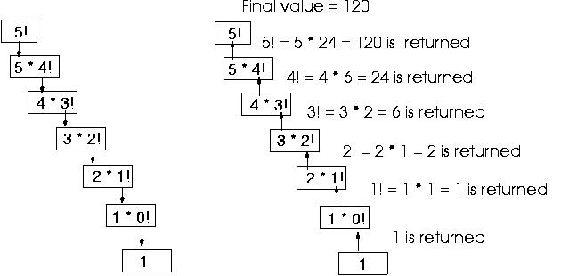
Tracing the example
public int factorial(int a){
if (a==0)
return(1);
else
return(a * factorial( a-1));
}
RECURSION !

Slide 44
Watching the Stack
public int factorial(int a){
if (a==1)
return(1);
else
return(a * factorial( a-1));
}
a = 1
Return to L4
a = 2
Return to L4
a = 3
Return to L4
a = 4
a = 4
Return to L4
…
Return to L4
a = 5
a = 5
a = 5
Initial
After 1 recursion
After 4th recursion
Every call to the method creates a new set of local variables !

Slide 45
Watching the Stack
public int factorial(int a){
if (a==1)
return(1);
else
return(a * factorial( a-1));
}
a = 1
Return to L4
a = 2
a = 2*1 = 2
Return to L4
Return to L4
a = 3
a = 3
a = 3*2 = 6
Return to L4
Return to L4
Return to L4
a = 4
a = 4
a = 4
a = 4*6 = 24
Return to L4
Return to L4
Return to L4
Return to L4
a = 5
a = 5
a = 5
a = 5
a = 5*24 = 120
After 4th recursion
Result

Slide 46
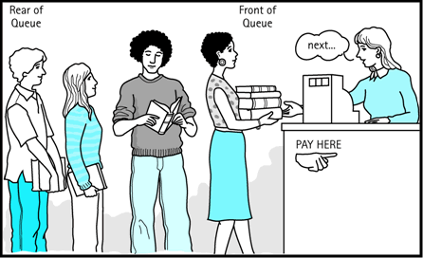
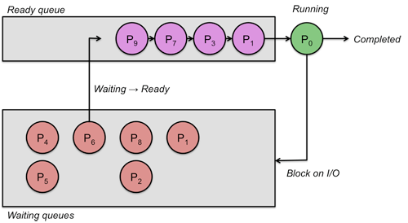
Queue : FIFO
First come first serve, e.g., restaurant waitlist.
Operating system often maintains a queue of processes that are ready to execute, or that are waiting for an event to occur.
Buffers
Notes:
Because items must be removed in exactly the same order as there were added to
the queue, a queue is called a first-in/first-out (FIFO) data structure.
Buffer: Computer systems must often provide a “holding area” for messages between two processes, two programs, or even two systems. This holding area is usually called a “buffer” and is often implemented as a queue.

Slide 47
Queue in Java - FIFO
import java.util.LinkedList;
import java.util.Queue;
public class StringQueue {
public static void main(String[] args) {
Queue<String> stringQueue = new LinkedList<String>();
stringQueue.add("first");
stringQueue.add("second");
stringQueue.add("third");
//infinite loop—equivalent to peek() in stack
while(!stringQueue.isEmpty()) System.out.println(stringQueue.element());
System.out.println("First In First Out:");
while(!stringQueue.isEmpty())
System.out.println(stringQueue.remove());
}
}

Slide 48
Queue Operations
Insert at rear:
enqueue(6)
rear
6
rear
6
5
4
3
2
front
5
Remove from front:
dequeue()
4
3
2
1
1
This is the first element of the queue
front

Slide 49
Exceptional Situations
QueueUnderflowException QueueOverflowException
rear
enqueue()
Queue is empty!
isEmpty()==true
Queue is full!
isFull() == true
12
rear
11
10
9
front
8
7
6
dequeue()
5
4
3
2
front
1

Slide 50
Stack vs queue

Slide 51
Queue Functions
add(E e) - exception : return head and remove
offer(E e) -boolean :return head and remove
element() , peek() : return the head
remove()
isEmpty()

Slide 52
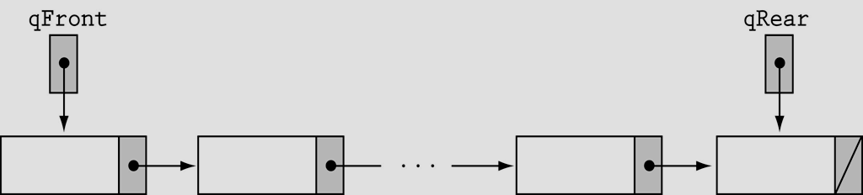
Queue: isEmpty()
int manyItems =0
Java Code:
public boolean isEmpty(){
if (manyItems==0) return true;
else return false;
}
null

Slide 53
Queue: ADD and remove
Always add the to rear of a queue.
Always remove from the front of a queue.
add if the queue is not empty:
rear.addNodeAfter(data)
rear=rear.getLink()
remove if queue is not empty:
front=front.getLink()

Slide 54
Queue Exercises
How to determine a string is Palindrome?
What a Palindrome?
ABCCBA
if ( s.pop( ) != q.remove( ) )
return false;
ABDCBA
A
ABCDBA
A
B
B
D
D
C
C
B
B
A
A
Stack<Character> s
Queue<Character> q
Notes:
A palindrome is a string that reads the same forward and backward, i.e., the letters are the same whether you read them from right to left or from left to right.

Slide 55
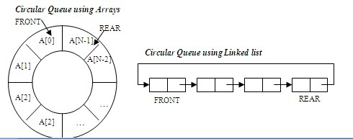
Circular Queue
Good memory management vs ordinary queues
E.g., computer controlled traffic system
Notes:
The idea of a circular array is that the end of the array “wraps around” to the start of the array.
Memory management: The unused memory locations in the case of ordinary queues can be utilized in circular queues

Slide 56
The mod Operator
The mod operator (%) is used to calculate remainders:
1%5 = 1, 2%5 = 2, 5%5 = 0, 8%5 = 3
mod can be used to calculate the front and back positions in a circular array:
The back of the queue is:
(front + count) % items.length
where count is the number of items currently in the queue
New front after removing an item the front of the queue is:
(front + 1) % items.length;

Slide 57
Insert
front =
0
//Java Code
Queue q = new Queue();
q.add(6);
count =
1
0
6
0
1
2
3
4
5
rear =(front + count) % items.length

Slide 58
Insert
//Java Code
Queue q = new Queue();
q.add(5);
q.add(4); ….
front =
1
6
5
4
3
2
1
0
1
2
3
4
5
front=(front + 1) % items.length

Slide 59
Remove
//Java Code
q.remove();
q.add(8);
front =
1
5
4
3
2
1
0
1
2
3
4
5
count=
5
front=(front + 1) % items.length
rear =(front + count) % items.length
rear = 0

Slide 60
Insert and Remove
//Java Code
q.add(8);
q.remove();
q.add(10);
front =
2
front =
1
8
10
4
3
2
1
0
1
2
3
4
5
rear=
1
front=(front + 1) % items.length
rear =(front + count) % items.length

Slide 61
Queue and Stack Exercises
Simulate a queue with 2 stacks.
What is the difference between a queue and a stack?
We have a String of characters. Write a function that will find the first non-repeating character using 1 queue.
Propose a data structure which supports the stack Push and Pop operations and a third operation FindMin,which returns the smallest element in the data strucuture all in O(1) worst case time.

